Slide 1
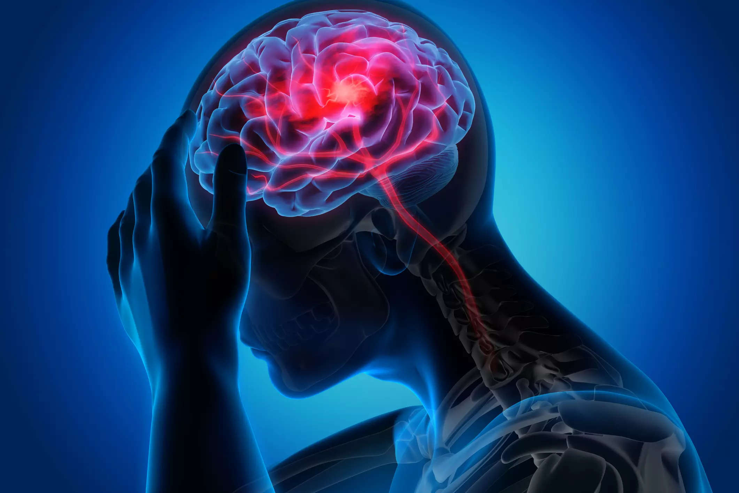

STROKE PREDICTION
Link : https://www.kaggle.com/fedesoriano/stroke-prediction-dataset
Dataset : healthcare-dataset-stroke-data.csv

Slide 2

GOAL :
According to the World Health Organization (WHO) stroke is the 2nd leading cause of death globally, responsible for approximately 11% of total deaths. This dataset is used to predict whether a patient is likely to get stroke based on the input parameters like gender, age, various diseases, and smoking status. Each row in the data provides relevant information about the patient.

Slide 3
VARIABLES INVOLVED:
id: unique identifier
gender: "Male", "Female" or "Other"
age: age of the patient
hypertension: 0 if the patient doesn't have hypertension, 1 if the patient has hypertension
heart disease: 0 if the patient doesn't have any heart diseases, 1 if the patient has a heart disease
ever married: "No" or "Yes"
work type: "children", "Govt_jov", "Never_worked", "Private" or "Self-employed"
Residence type: "Rural" or "Urban"
avg_glucose_level: average glucose level in blood
bmi: body mass index
smoking_status: "formerly smoked", "never smoked", "smokes" or "Unknown"*
stroke: 1 if the patient had a stroke or 0 if not

Slide 4
MY LEARNING:
Concept of Logistic Regression
To perform Exploratory Data Analysis
Treating Outliers
Feature Engineering
Standard Scaling
Label Encoding
Oversampling technique - SMOTE
Building the model using - liblinear solver , using Newtons' - cg solver, saga solver

Slide 5
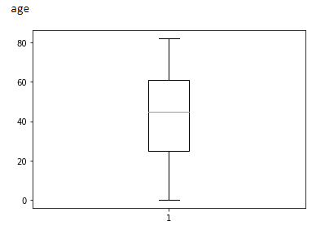
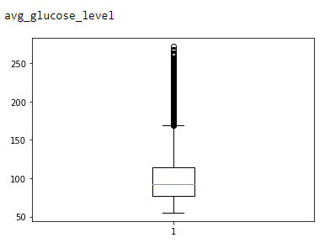
DATA CLEANING :
Using Boxplot to visualize outliers for each feature :

Slide 6
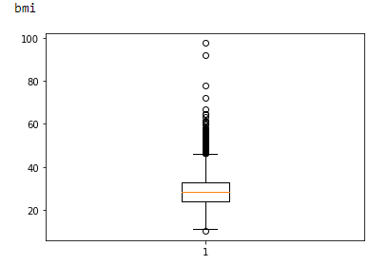

Slide 7
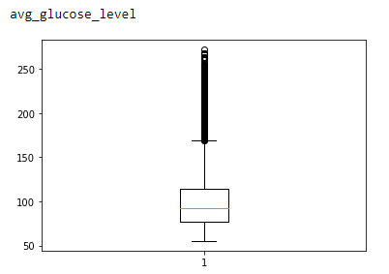
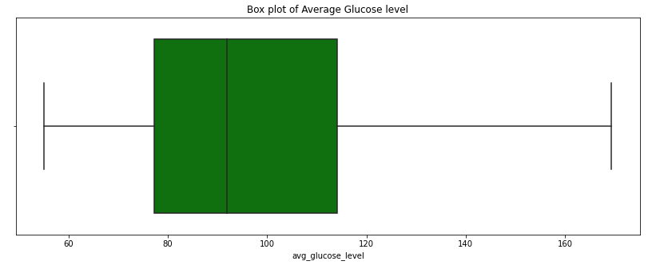
Outliers Treatment :
After treating outliers

Slide 8
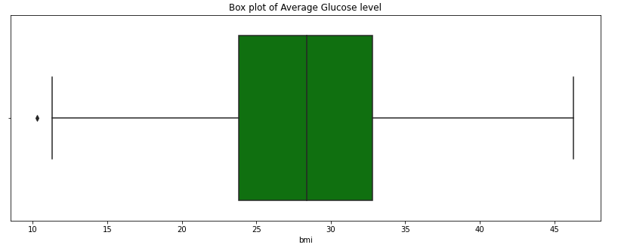
After treating outliers

Slide 9
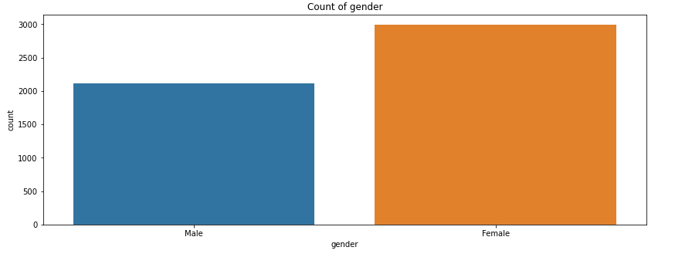
MAJOR FINDINGS THROUGH EDA:
Gender :
We have 2994 female and 2115 male.

Slide 10
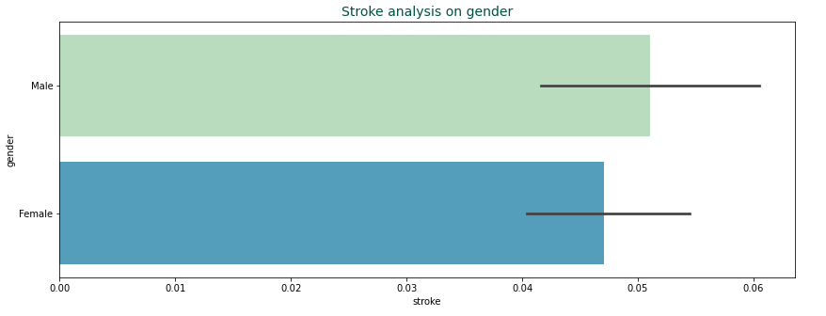

Slide 11
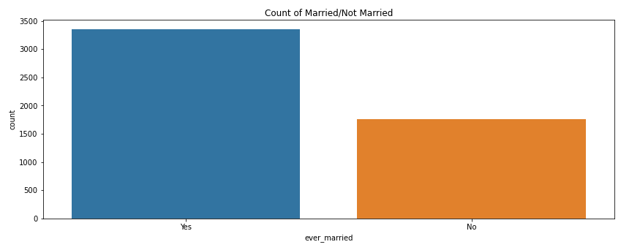
Ever married :
3353 people have been married and 1757 people are not married before.

Slide 12
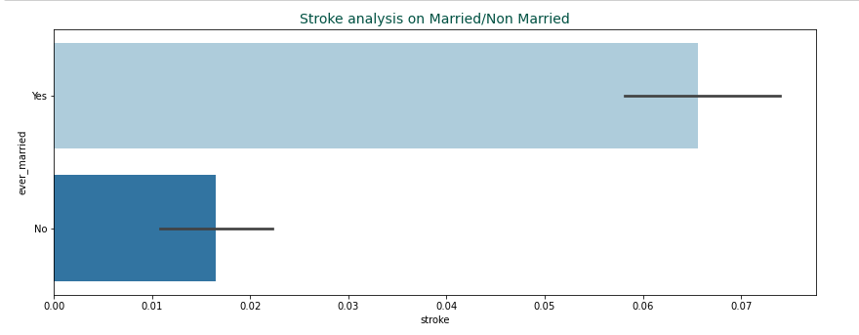

Slide 13
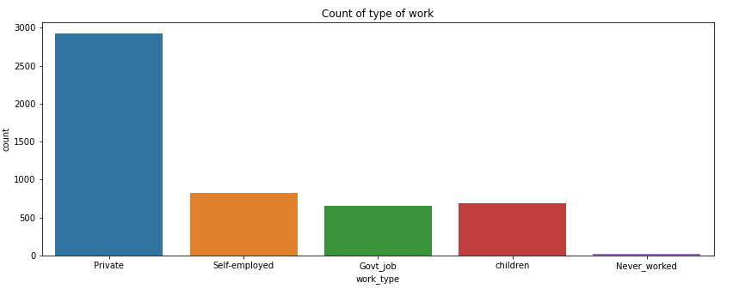
work_type:
2925 people work in the private sector.
819 people are self-employed
657 people work at the government job.

Slide 14
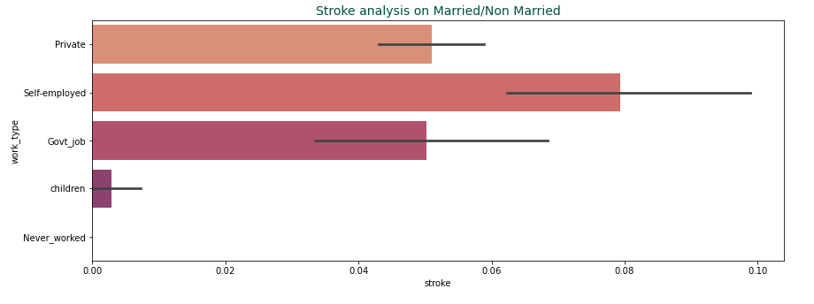

Slide 15
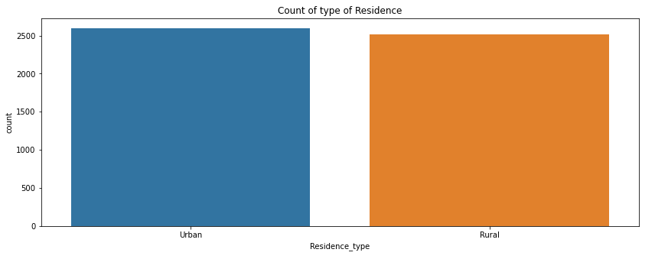
Residence_type

Slide 16
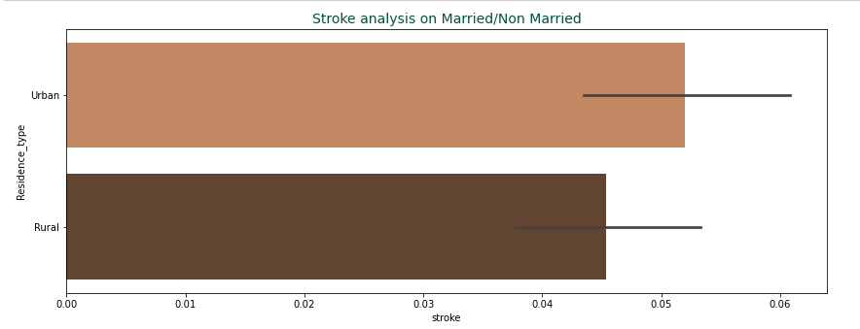

Slide 17
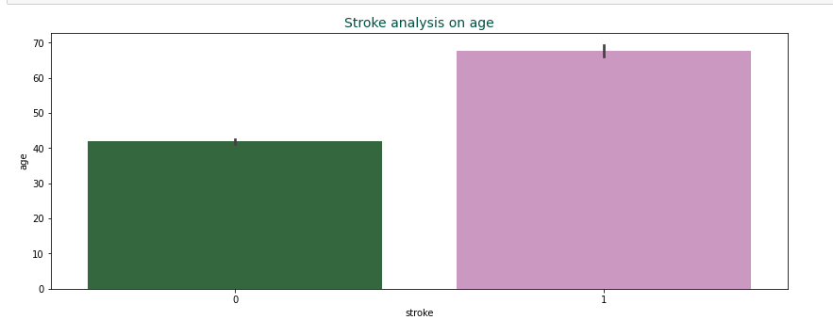
Age :

Slide 18
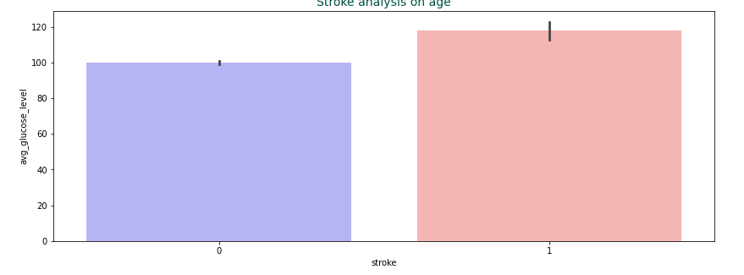
avg_glucose_level :

Slide 19
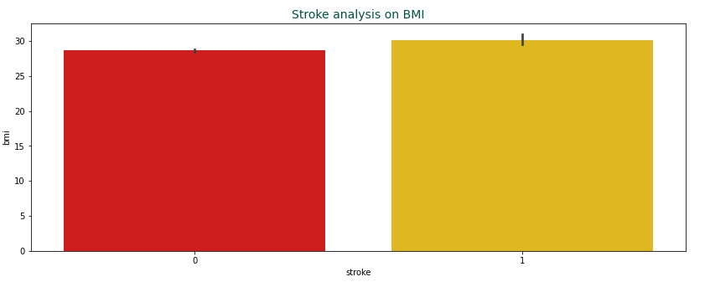
bmi :

Slide 20
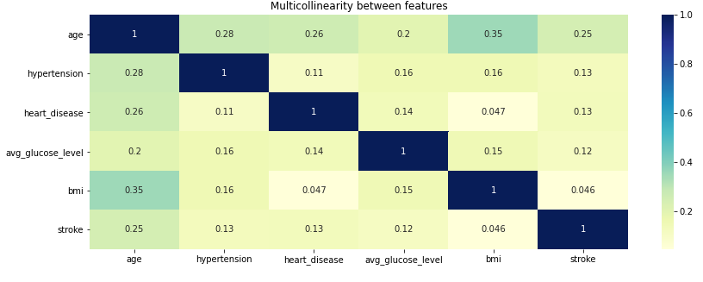
HEATMAP :
As visible from the heatmap:
'age' and 'bmi' are correlated fairly high. This shows that the bmi tends to increase with an increase in age.
'age' and 'hypertension' are also quite correlated. This is alarming for our society, as this implies poorer mental health conditions among elders.

Slide 21
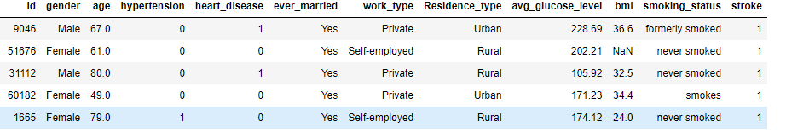
DATA MANIPULATION :
Standard Scaler :
Used to scale the continuous features. This arranges the data in a standard normal distribution, with mean as 0 and standard deviation as 1.
BEFORE

Slide 22
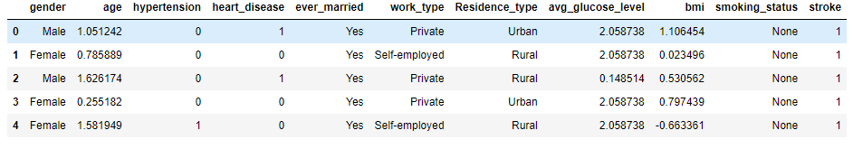
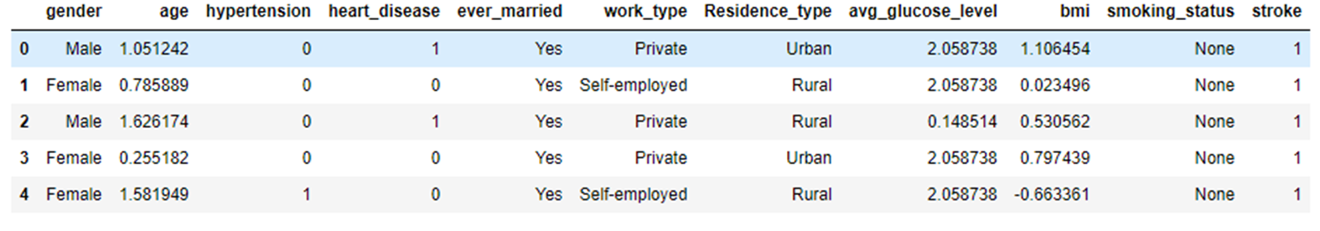
AFTER
Label Encoding :
Converting the labels into a numeric form so as to use it to fit and evaluate a model.
BEFORE

Slide 23
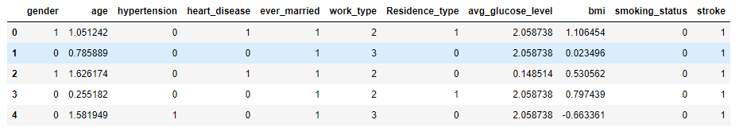
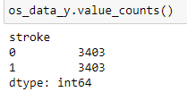
AFTER
SMOTE - Synthetic Minority Oversampling Technique
SMOTE - Synthetic Minority Oversampling Technique is an oversampling technique where the synthetic samples are generated for the minority class. This algorithm helps to overcome the overfitting problem posed by random oversampling.
After SMOTE :

Slide 24
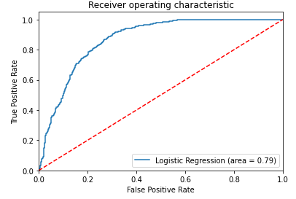
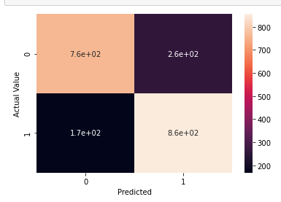
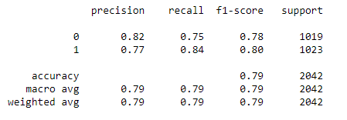
MODEL BUILDING :
MODEL 1 -Using liblinear solver (default) :

Slide 25
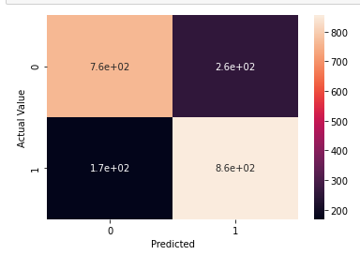
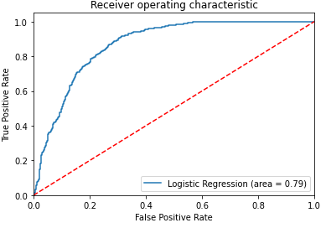
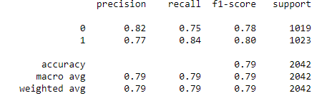
MODEL 2 : using Newtons' - cg solver :

Slide 26
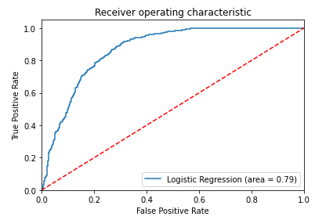
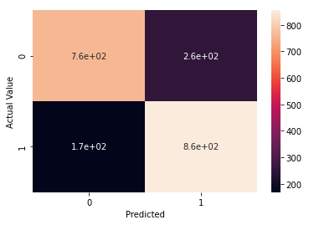
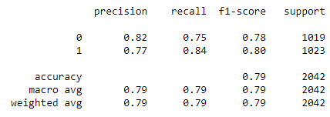
MODEL 3 – using SAGA solver :
CONCLUSION : All models are giving same accuracy.

Slide 27

Thanks for viewing my work!

